Slide 1
ACMA 231
Excel:
Functions Part 5

Slide 2
Excel: Functions Part 5
PMT(rate, nper, pv, fv, type)
i.e. “Calculates the payments for a loan (or annuity) based on constant payments and constant interest rate”
RATE(nper, pmt, pv, fv, type, guess)
Giving Excel a “starting point” to figure out the interest rate.
You can usually just enter a ballpark number, like 0.01.
i.e. “Returns the interest rate per period of a loan or an investment”
NPER(rate, pmt, pv, fv, type)
i.e. “Returns the number of periods for an investment based on periodic, constant payments and a constant interest rate”

Slide 3
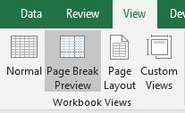
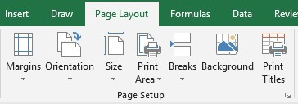
Excel: Functions Part 5 ~ Print Preparation

Slide 4
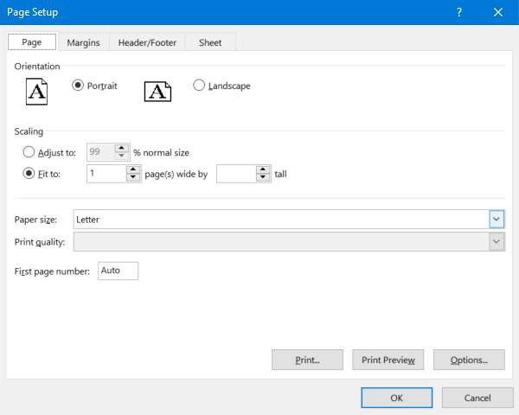
Excel: Functions Part 5 ~ Print Preparation

Slide 5
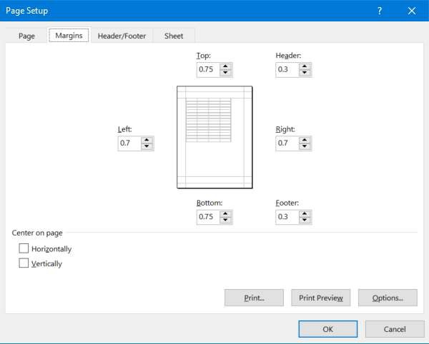
Excel: Functions Part 5 ~ Print Preparation

Slide 6
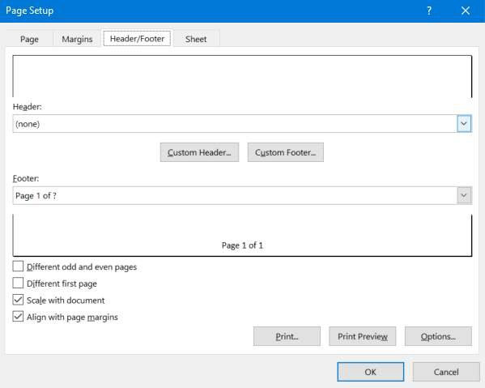
Excel: Functions Part 5 ~ Print Preparation

Slide 7
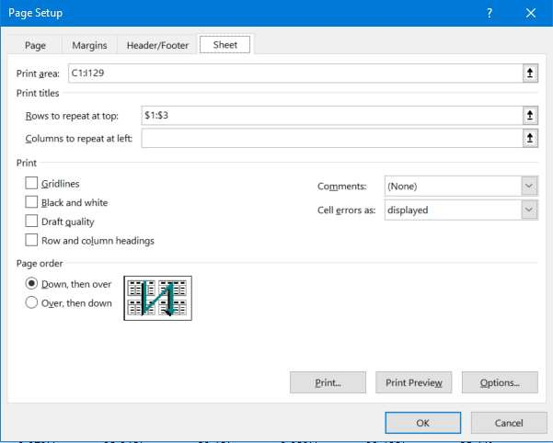
Excel: Functions Part 5 ~ Print Preparation

Slide 8
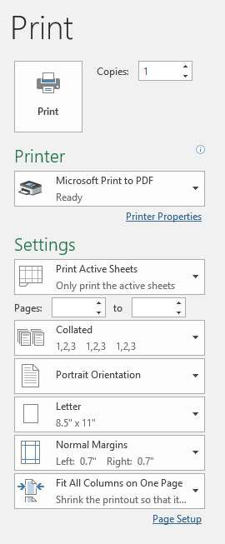
Excel: Functions Part 5 ~ Print Preparation
Print Preview File -> Print Or
Page Layout -> Page Setup -> Print Preview
10

Slide 9

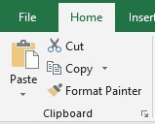
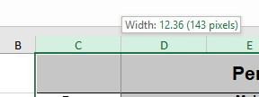
Excel: Functions Part 5 ~ Print Preparation
Some Additional Formatting:
Wrap Text: wrap extra long text into multiple lines within the same cell so that you can see all of it
Merge & Center: combine and center the contents of the selected cells in a new larger cell. This is a great way to create a label that spans multiple columns.
Format Painter: lets you copy all of the formatting from one group of cells and apply it to another group. Think of it as copying and pasting for formatting.
Column Widths: You can change the widths of multiple columns uniformly by highlighting the desired columns and then adjusting the width of the first column in your selection with your mouse. This will update all selected columns to be the same width.
11

